Slide 1

National Institute of Technology, Jamshedpur
Major Project on Human Activity Recognition using Smartphones
By:
Sourav Gupta (2015UGCS056)
Aditya Nihal Kumar Singh (2015UGCS061)
Md Salman Kashif (2015UGCS066)
Under the guidance of Prof. Sanjay Kumar (Department of Computer Science & Engineering)

Slide 2
Contents
Problem Statement………………………………………………………………………3
Introduction…………………………………………………………………………………4
Motivation……………………………………………………………………………………5
About the dataset………………………………………………………………………..6
Proposed Methodology………………………………………………………………..7
Hardware & Software Requirements…………………………………………….9
Implementation………………………………………………………………………...10
Results………………………………………………………………………………….......18
Conclusion………………………………………………………………………………….22
Scope of Improvement…………………………………………………………......23
References.....................................................................................24

Slide 3
Problem Statement
In this project, we propose a human activity recognition system robust in terms of orientation, placement and subject variations based on various machine learning models like:
Support Vector Machines
Principal Component Analysis
Random Forest
K Nearest Neighbors
Logistic Regression
Finally, we analyze the performance of various models on the given dataset.

Slide 4
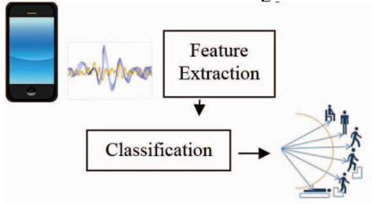
Introduction
In the project of Human Activity Recognition, we use Machine Learning to classify the activities of daily living like:
Walkup
Walkdown
Walk
Laying
Standing
Sitting
using smartphone with embedded inertial sensors.

Slide 5
Motivation
Human activity recognition using either wearable devices or smartphones can benefit various applications like:
Healthcare monitoring
Fitness Applications
Smart homes
Security and surveillance applications, etc.
Instead of using wearable devices which are intrusive and require extra cost, we shall leverage on modern smartphones embedded with a variety of sensors.

Slide 6
About the Dataset
We adopted our dataset from Kaggle:
https://www.kaggle.com/uciml/human-activity-recognition-with-smartphones/home
For each record in the dataset the following is provided:
Triaxial acceleration from the accelerometer (total acceleration) and the estimated body acceleration.
Triaxial Angular velocity from the gyroscope.
A 561-feature vector with time and frequency domain variables.
Its activity label.
An identifier of the subject who carried out the experiment.

Slide 7
Proposed Methodology
We start with our raw dataset
Split this dataset into train & test
Build our base model using all 561 variables
Select variables using feature extraction
Iterate over this process till final model
Do this for all the proposed classifiers
Compare accuracy, precision, recall etc. of the above mentioned classifiers

Slide 8
Raw Dataset
Training set: 70%
Test set: 30%
Is it accurate enough?
Base Model
N
Feature Extraction
Y
Next classifier
Model Training
All classifiers done?
Y
Compare Result
N

Slide 9
Hardware and Software Requirements
Hardware Requirements:
Core i5 Processor
8 GB RAM
2 GB GPU
Software Requirements
Anaconda
Python on Jupyter Notebook

Slide 10
Implementation of Random Forest
Imported packages and data.
Built the random forest model containing all 561 variables
Plotting variable importance graph with respect to each variable.
Chose top 25 variables according to their feature importance.
Finally selected first four features and the seventh feature for our final evaluation using random forests.
Deciding the number of trees to be used in training the classifier.
Found out the confusion matrix for our training and test data.

Slide 11
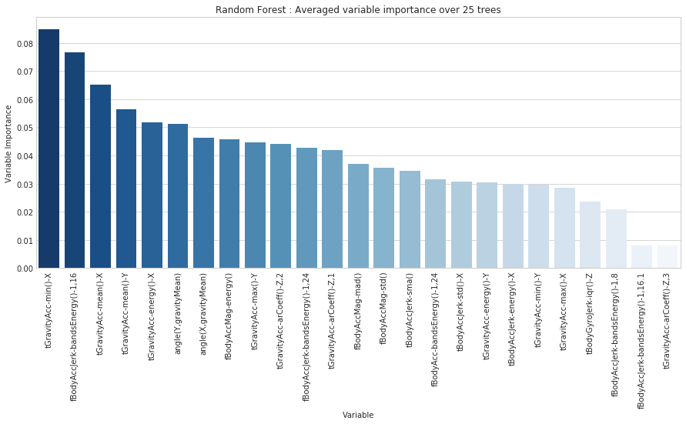
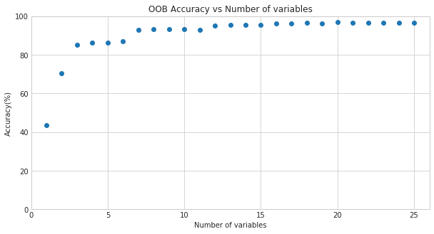
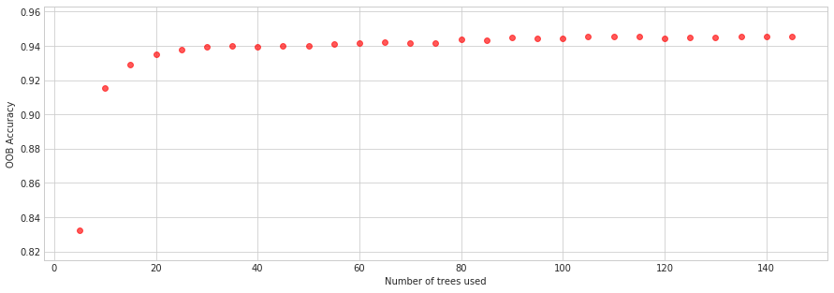

Slide 12
Implementation of KNN
Imported packages and data.
Built the model using all 561 variables
Selecting the number of neighbors
Applying Principal Component Analysis (PCA) for dimensionality reduction
Selecting number of components using PCA
Selecting number of neighbors after PCA reduction
Found out the results

Slide 13
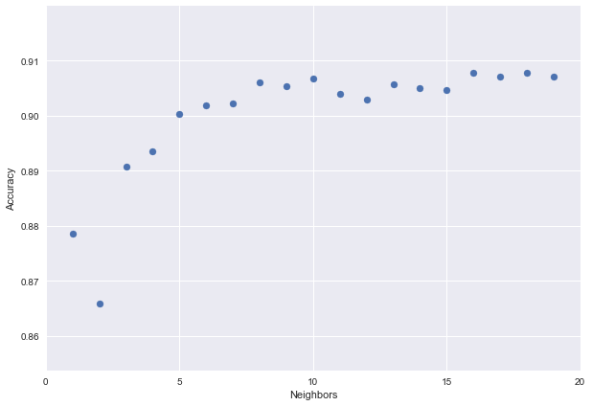
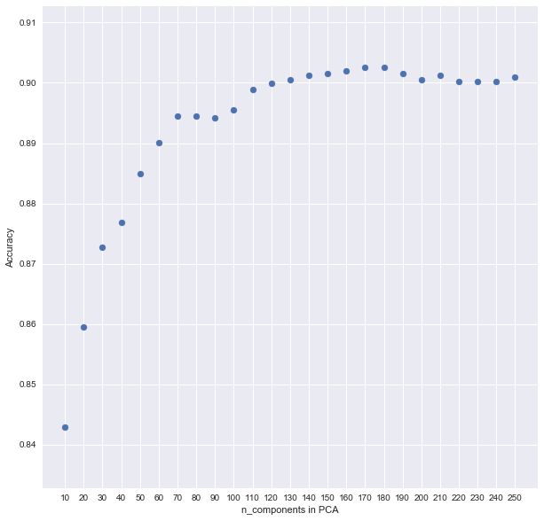


Slide 14
Implementation of Logistic Regression
Imported packages and data.
Built the model using all 561 variables
Selecting the value of regularization parameter, C
Applying Principal Component Analysis (PCA) for dimensionality reduction
Selecting number of components using PCA
Selecting value of regularization parameter after PCA reduction
Found out the results

Slide 15
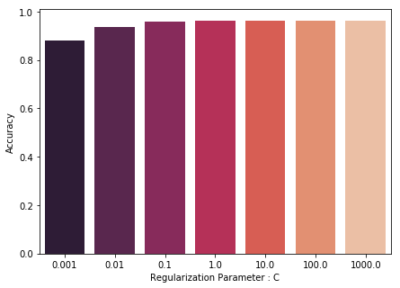
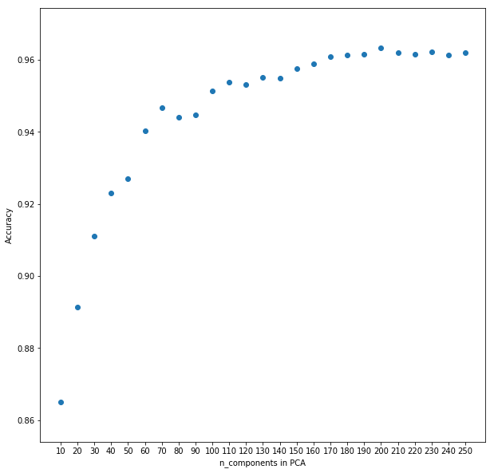
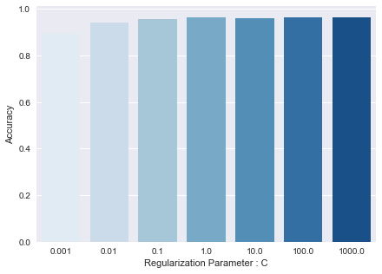

Slide 16
Implementation of SVM
Imported packages and data.
Built the model using all 561 variables
Selecting the kernel among rbf, poly, linear and sigmoid
Selecting the value of regularisation parameter, C
Applying Principal Component Analysis (PCA) for dimensionality reduction
Selecting number of components using PCA
Found out the results

Slide 17
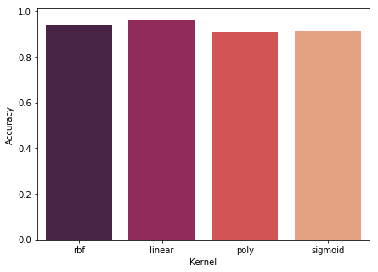
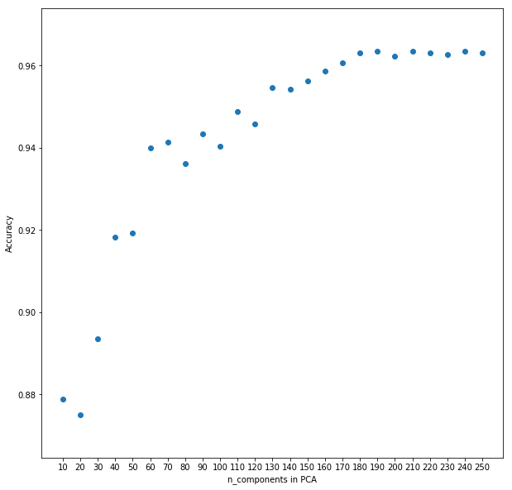
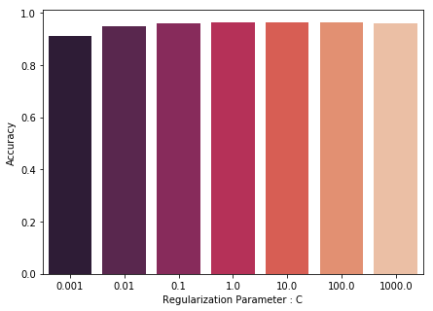

Slide 18
Results

Slide 20
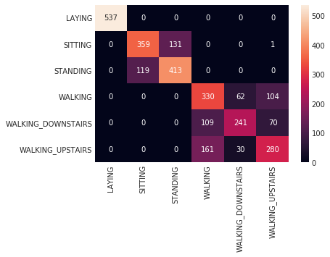
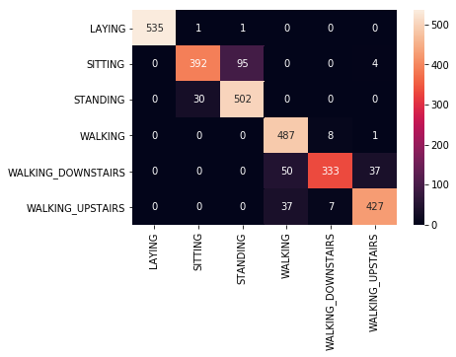
Confusion Matrix for Random Forest Confusion Matrix for KNN
Fig 32: Confusion Matrix for SVM

Slide 21
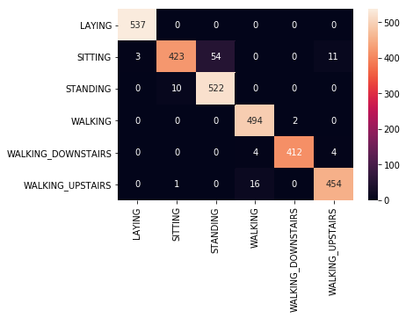

Confusion Matrix for Logistic Regression Confusion Matrix for SVM

Slide 22
Conclusion
The best classification rate in our experiment were 96.33% and 96.44%, which were achieved by SVM and Logistic Regression respectively. Among the four classifiers, KNN and SVM improve most after applying feature extraction and dimensionality reduction using PCA. Conclusively, Logistic Regression and SVM are the optimal choice for our problem.

Slide 23
Scope of Improvement
Adding more data can improve accuracy
Having a better definition of activity like possibility of tagging multiple activities at the same data point
Sensor data collection from different types of smartphones can be significantly different. So, we end up using data from the same phone.
There exists a unique activity pattern for each user. So, personalized model for each user might improve the accuracy.

Slide 24
References
A Public Domain Dataset for Human Activity Recognition Using Smartphones. Davide Anguita, Alessandro Ghio, Luca Oneto, Xavier Parra and Jorge L. Reyes-Ortiz. 21st European Symposium on Artificial Neural Networks, Computational Intelligence and Machine Learning, ESANN 2013. Bruges, Belgium 24-26 April 2013.
Human Activity Recognition via Cellphone Sensor Data. Wei Ji, Heguang Liu, Jonathan Fisher. Stanford University. 2016 Fall CS229 Project Report
Robust Human Activity Recognition Using Smartphone Sensors via CT-PCA and Online SVM. Zhenghua Chen, Qingchang Zhu, Yeng Chai Soh, Le Zhang. IEEE Transactions on Industrial Informatics PP(99):1-1 · June 2017

Slide 25
References
Recognizing human activities from multi-modal sensors. Shu Chen and Yan Huang. Intelligence and Security Informatics, 2009. ISI ’09. IEEE International Conference on, Dallas, TX, 2009, pp. 220-222.
Human Activity Recognition using Smartphone. Amin Rasekh, Chien-An, Chen Yan Lu. Texas A&M University. 2011 Fall CSCE666 Project Report
Human Activity Recognition on Smartphones using a Multiclass Hardware-Friendly Support Vector Machine. Davide Anguita, Alessandro Ghio, Luca Oneto, Xavier Parra and Jorge L. Reyes-Ortiz. International Workshop of Ambient Assisted Living (IWAAL 2012). Vitoria-Gasteiz, Spain. Dec 2012
Human activity recognition using smartphone's sensors and machine learning; Enrique Alejandro Garcia Ceja. Instituto Tecnológico y de Estudios Superiores de Monterrey; 2012

Slide 26
THANK YOU

